Slide 1
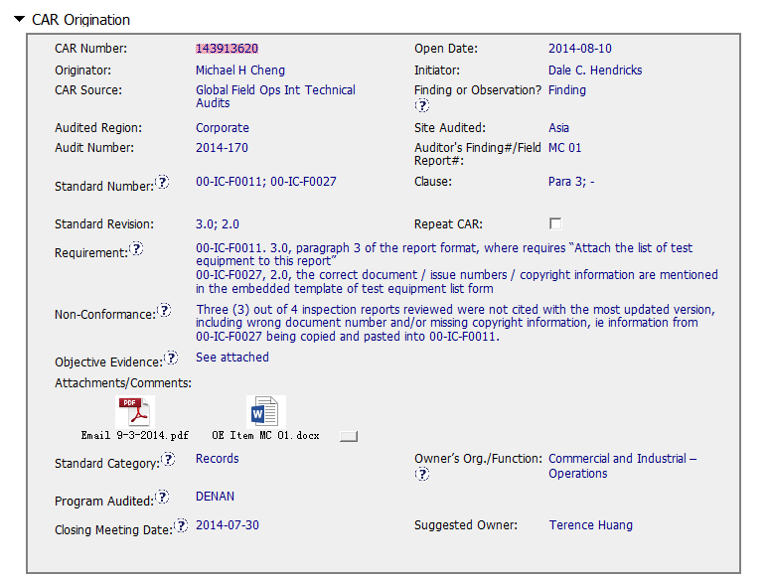
CAR 143913620 – Origination(1)
Requirement: suggest to include more here for Para./Item 3 “test equipment” . (See attachment 1 -Email shows “we will need to use form 00-IC-F0027 as intended and submit it in as part of the inspection information…not to copy over information from this form to the inspection report” by initiator)
Suggest to include conclusions after confirmed with program/document owners on the intended use of form 00-IC-F0027 in relation to 00-IC-F0011.
Objective Evidence: very clear mail communication among originator, initiator, original/ new owner and program owner provided. - Excellent
The screenshots and specific information provided as evidences. Suggest to attach those 3 pcs reviewed 00-IC-F0011 Factory Inspection Report, issue 3.0.
Clear description of standard category, program audited and suggest owner.
Attachment 1 indicated the reason why CAR champion reassigned it to a different Owner.
Collaboration (L) : Reference communications are attached as needed - Excellent

Slide 2
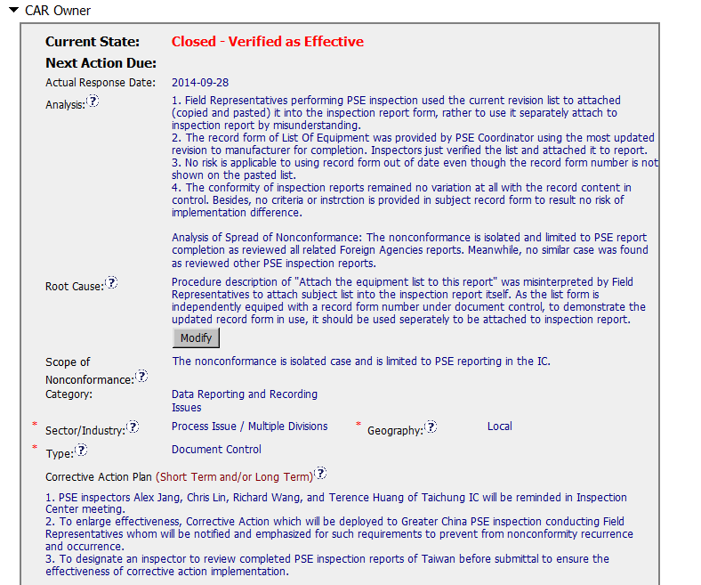
CAR 143913620 – Owner(2)
Analysis:
Stakeholders are not clearly identified.
Should explore further to find out bottom line reason ,such as why the 00-IC-F0011 item 3 description was misinterpreted, any duties already identified and implemented, any refresh training conducted for intent use of 00-IC-F0027/0011.etc.
Root cause: should be concise, one or two sentences summarizing the bottom line reason ,and naturally flew from above analysis. “As…, it should be …” should be removed to “CAP” section.
Appropriate “scope” are filled in after analysis, and “category”, “type”, “geography” are selected correctly.
[Competitiveness] (C) – Analysis shows clear path to root cause and scope and stakeholders identified. - Moderate.
[Competitiveness( (C) - Root cause statement is succinct, reasonable, complete.- Moderate.
[Integrity] (T) – Most appropriate ‘category’, ‘type’, ‘geography’ are selected.-Excellent.

Slide 3
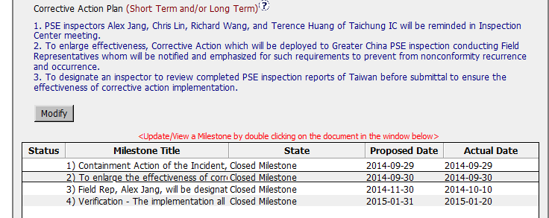
CAR 143913620 – Owner(3)
Corrective Actions Plan: should match with Milestone section
•- Milestone 1: should be named as “Containment Action” to fix objective evidences. Following slide - M1 shows that no need to revise 3 inspection reports, but lacking of reasons indicated in “CAP” section.
•- Milestone 2/3 : should be named as “Short term / Long term”: to address the root cause(if being identified as “misinterpreted by Field Representative to attach equipment list to report…” ) and scope identified in “Analysis”.
•- -Milestone 4: Should have final milestone for owner’s verification of effectiveness in “CAP” section.

Slide 4
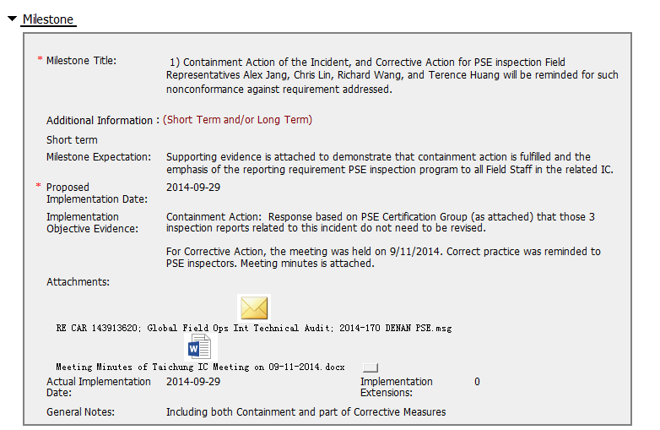
CAR 143913620 – Milestone 1(4)
Milestone 1 indicates reason why not required to fix objective evidence with attachment ,see program owner reply.
Containment action has been done with clear implementation objective evidences.
[Competitiveness] (C) – Milestone addressed containment and completed per milestone expectation.
- Excellent.

Slide 5
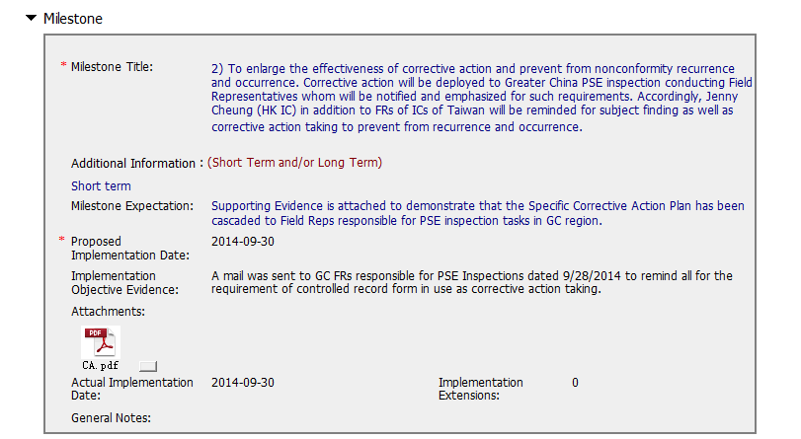
CAR 143913620– Milestone 2(5)
Short term action has been done with clear implementation objective evidences.
[Competitiveness] (C) –Corrective actions fix the objective evidence and other problems found; address entire root cause and scope. - Excellent

Slide 6
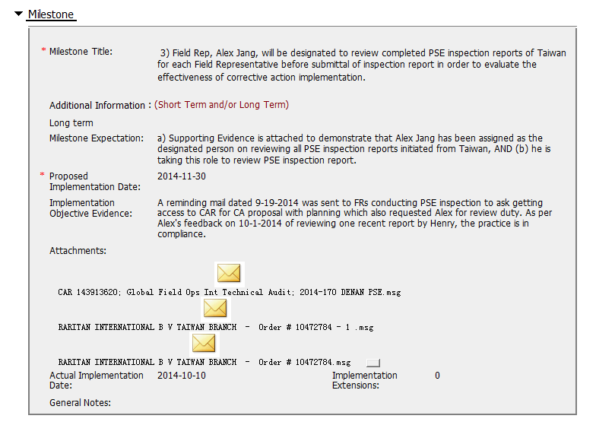
CAR 143913620– Milestone 3(6)
Suggest to offer formal assignment as evidence ,as the reminding mail to whole team did not include duty descriptions for Alex Jiang.
The 2nd long term action has been done with clear implementation objective evidences.
[Competitiveness] (C) –Corrective actions fix the objective evidence and other problems found; address entire root cause and scope. - Moderate

Slide 7
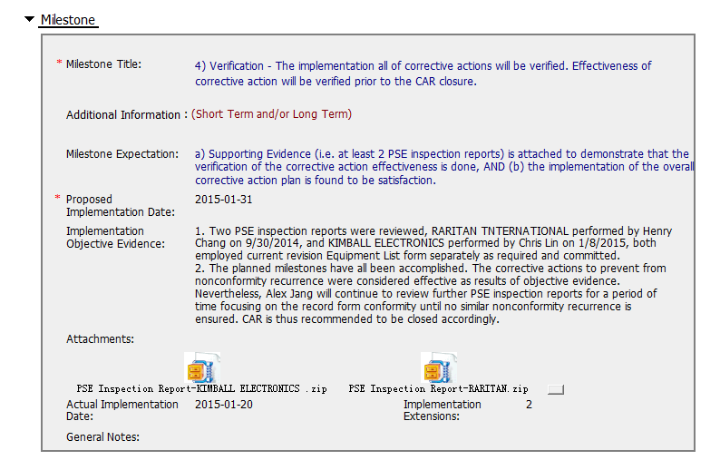
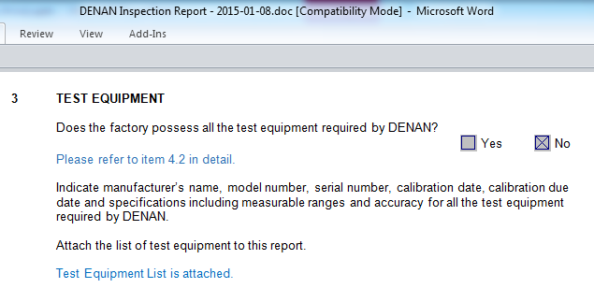
CAR 143913620– Milestone 4(7)
Verification action has been done with clear implementation objective evidence. See below screenshot.
[Competitiveness] (C) – Milestone addressed Verification and completed per milestone expectation.
-Excellent.

Slide 8
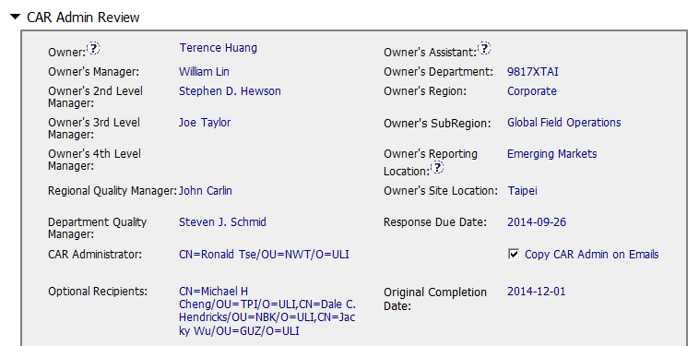
CAR 143913620– CAR Admin Review(8)
Correct input of Owner’s reporting manager.

Slide 9
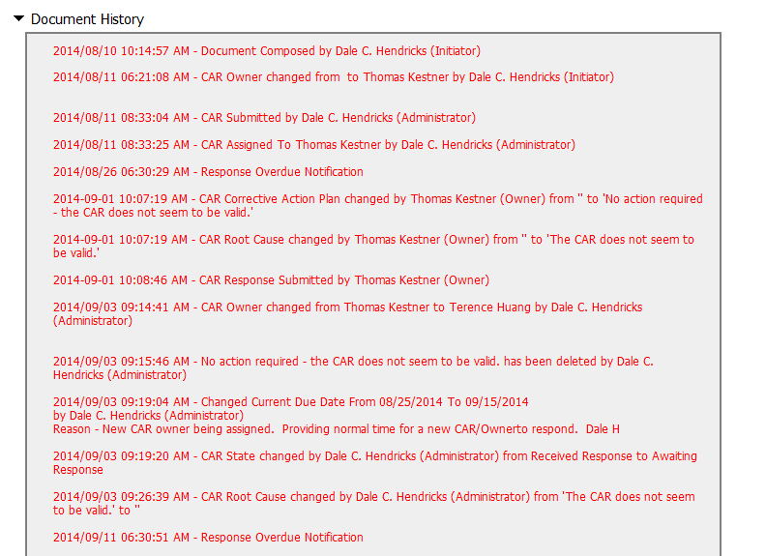
CAR 143913620 – History Study(9)
[Integrity] (T) - Acts on CARs within required timeframe – Need improvement.
[Integrity] (T) - No Extensions, No overdue, No escalated, No disputed – Need improvement.
[Collaboration](L) - Referenced communications are attached as needed – Need improvement.

Slide 10
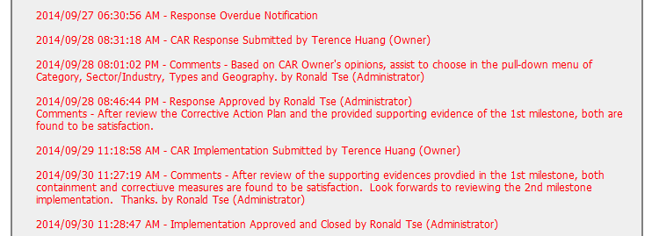
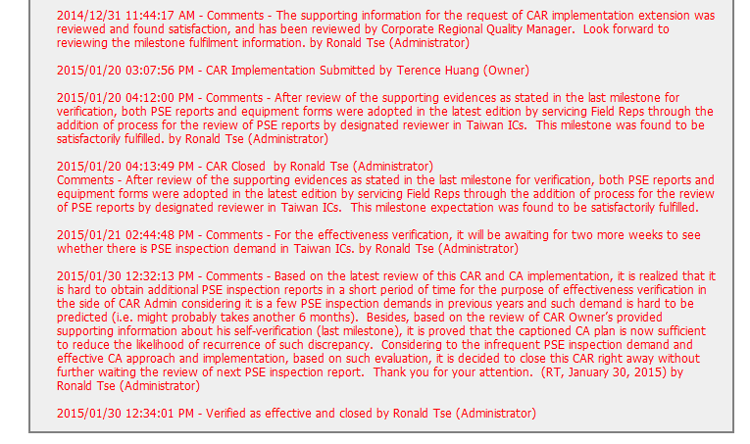
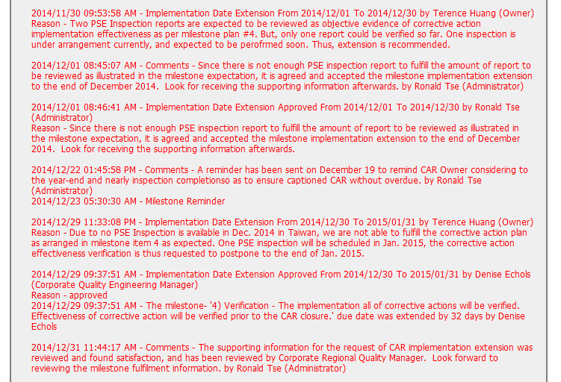
CAR 143913620– History Study(10)
Evidence of communication with CAR owners when CAR goes overdue, see CAR milestone 1 –Attached mail dated on Sep.28.
Collaboration with the CAR owner is apparent from the comments.
Documented decisions and rationale in CAR Champion verification stage.
Granting reasonable extensions as shown by documented rationale.
Suggest to ensure Extensions – within requirements (<30 days)
[Integrity] (T) - Acts on CARs within required timeframe – Need improvement.
[Integrity] (T) - No Extensions, No overdue, No escalated, No disputed – – Need improvement.
[Collaboration](L) - Referenced communications are attached as needed – Excellent.

Slide 11
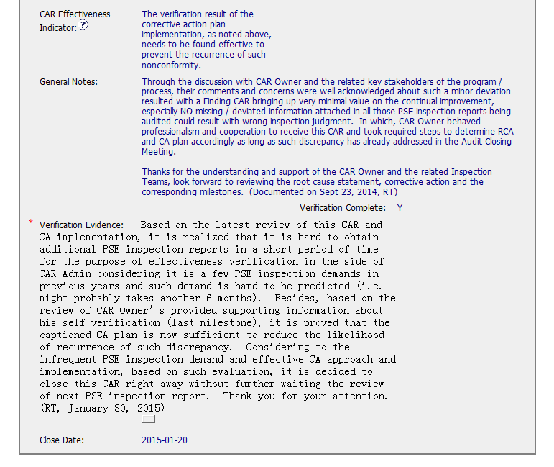
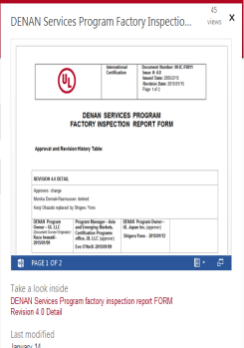
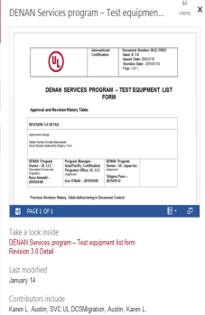
CAR 143913620 – Admin Verification(11)
Collaboration with the CAR owner is apparent from the whole CAR handling process.
The rationale is documented and reasonable.
Usually to verify Finding CAR within 6-9 months after closure, see “CAR Admin. Performance Measurement” issued in Apr.2014.
Suggest to verify 2 more months considering the revised 00-IC-F0011_V4.0 & F0027_V3.0 published on Jan. 15. 2015 .
[Competitiveness](P) Verification per requirements. – Moderate.

Slide 12
CAR 143913620– CBS Check(12)
CBS Requirements | Excellent | Moderate | Need Improve | N/A
(C) Extensions are within requirement (<30 days, 3 or less) |  |  | X
(T) Most appropriate ‘category’, ‘type’, ‘geography’ are selected | X
(P) Facilitates the handling of disputed CARs | X
(T) Acts on CARs within required timeframe |  |  | X
(C) Analysis shows clear path to root cause and scope; stakeholders identified |  | X
(C) Root cause statement is succinct, reasonable, complete (Shows ‘N/A’ for observations) |  | X
(C) Corrective actions fix the objective evidence and other problems found; address entire root cause and scope. For observations, they do not go beyond fixing the objective evidence | X
(C) Milestones address containment & owner’s verification; completed per milestone expectations | X
(P) Verification per requirements |  | X
(L) Referenced communications are attached as needed | X
(C L) Evidence of communication for overdue/escalated CARs and other pertinent concerns |  | X
(P) Trains other CAR Champions |  |  |  | X

Slide 13
CAR 143913620 Finding

Slide 14
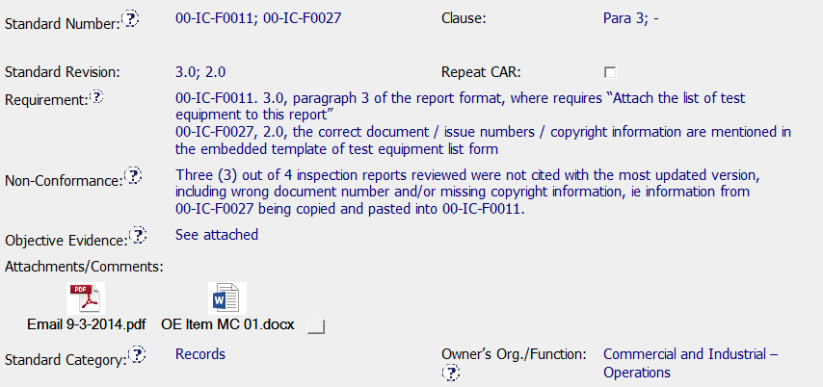
Requirement – Would consider using document control requirement and citing
00-IC-F001 and 00-IC-F0027 in objective evidence
Include at least the examples for the objective evidence
and then It is okay to refer to the attachments.
Attachments are excellent way to help CAR Owner
Standard category - Documentation may match nonconformance better

Slide 15
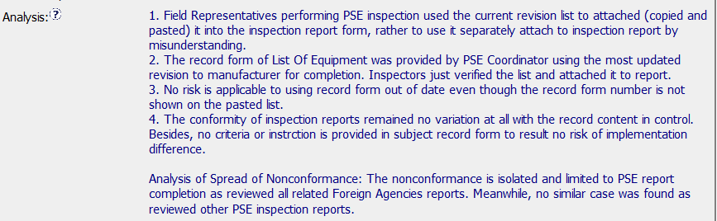
Specific Stakeholders?
Analysis indicates human error (misunderstanding) was responsible for not attaching the
00-IC-F0027 as required by the IC Form, but instead “pasting in” the equipment information
from Form 00-IC-F0027.
Would like to have seen additional details supporting human error. For example, three
different inspectors made the same mistake – Are IC Form instructions clear?
Training sufficient? Tool hard to use? Etc…
Spread of nonconformity –Sample size of PSE reports taken to determine
isolated case would have been helpful. “Reviewed Other PSE Reports” cited in analysis
This would also help to better support human error determination

Slide 16
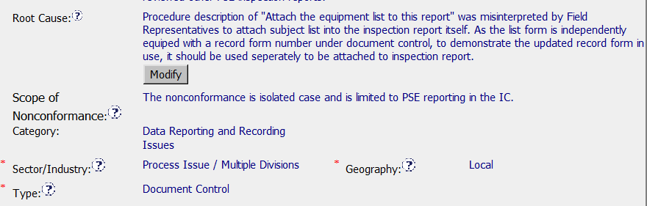
Root Cause - Would suggest a more concise statement.
As noted in analysis comments, not clear if human error is final root cause
Scope of nonconformance - As noted in analysis comments, additional
information supporting isolated occurrence would be helpful

Slide 17
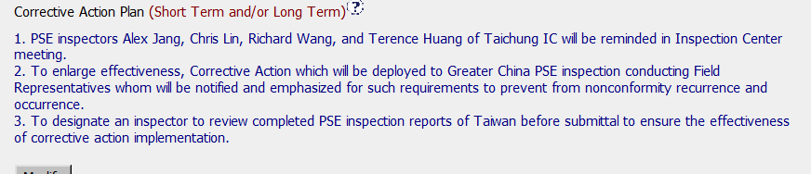
Corrective action does a nice job addressing the issue of attaching Form 00-IC-F0027
To 00-IC-F0010,
Determination made not to update objective evidence - Feel it is important to update
objective evidence, as Inspection Records could be reviewed by an accreditor.
Corrective action expanded to include Greater China

Slide 18
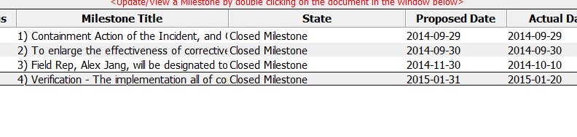
Containment and Verification milestones included
Objective evidence provided supports acceptance

Slide 19
INTEGRITY
Initiative & Decision Making Analyzing & Problem Solving | Facilitates progression of the CAR through closure: extensions, escalations, reassignments, etc. Accurately completes the administrative fields within the CAR such as root cause category, process impacted, geography, etc. Acts on CARs within the required timeframe Facilitates the handling of disputed CARs (C) Extensions are within requirement (<30 days, 3 or less) (T) Most appropriate ‘category’, ‘type’, ‘geography’ are selected (P) Facilitates the handling of disputed CARs (T) Acts on CARs within required timeframe
COMPETITIVENESS
Customer Focus Achieve Business Results Flexibility | Assists customers as they address all aspects of the CAR – analysis, root cause statement, milestone, containment, verification, etc. Verifies CARs timely (C) Analysis shows clear path to root cause and scope; stakeholders identified (C) Root cause statement is succinct, reasonable, complete (Shows ‘N/A’ for observations) (C) Corrective actions fix the objective evidence and other problems found; address entire root cause and scope. For observations, they do not go beyond fixing the objective evidence (C) Milestones address containment & owner’s verification; completed per milestone expectations (P) Verification per requirements
COLLABORATION
Leading & Engaging Teamwork Communication | Provides pertinent feedback at appropriate times; shares information and keeps others informed Supports other CAR Champions by serving as their backup when they are absent Works as a team player with other CAR Champions (L) Referenced communications are attached as needed (C L) Evidence of communication for overdue/escalated CARs and other pertinent concerns (P) Trains other CAR Champions

